Slide 1
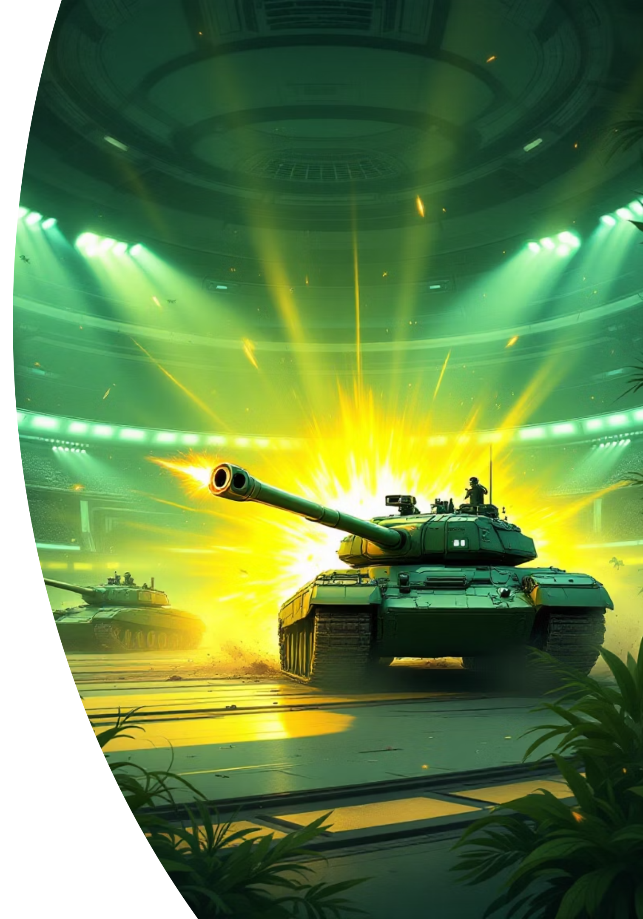
TANK ARENA
A 2D multiplayer battle experience where strategy meets firepower

Slide 2

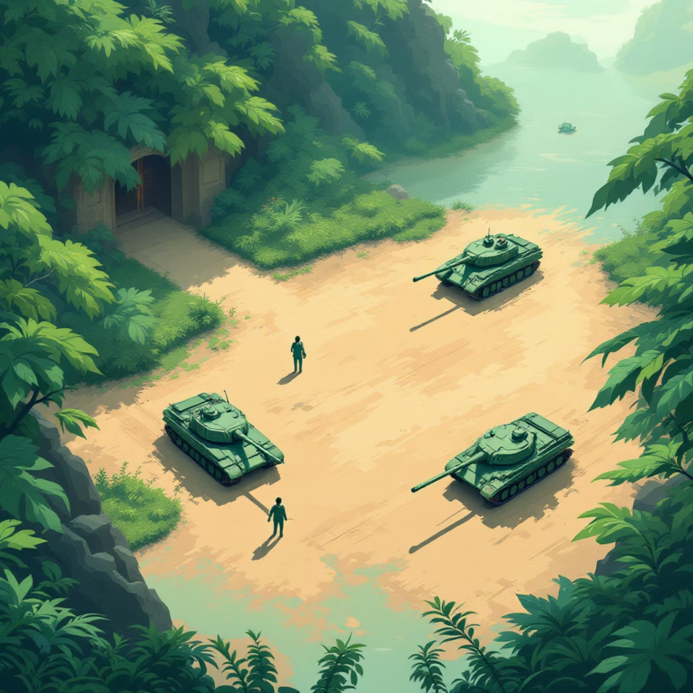
GAME CONCEPT
Welcome to the Battlefield
Core Gameplay
Tank Arena delivers intense 2D combat where precision aiming and tactical movement determine victory. Navigate treacherous terrain, dodge incoming fire, and unleash devastating attacks on your opponents.
Fast-paced multiplayer action
Strategic positioning mechanics
Progressive difficulty levels
Dynamic AI opponents

Slide 3
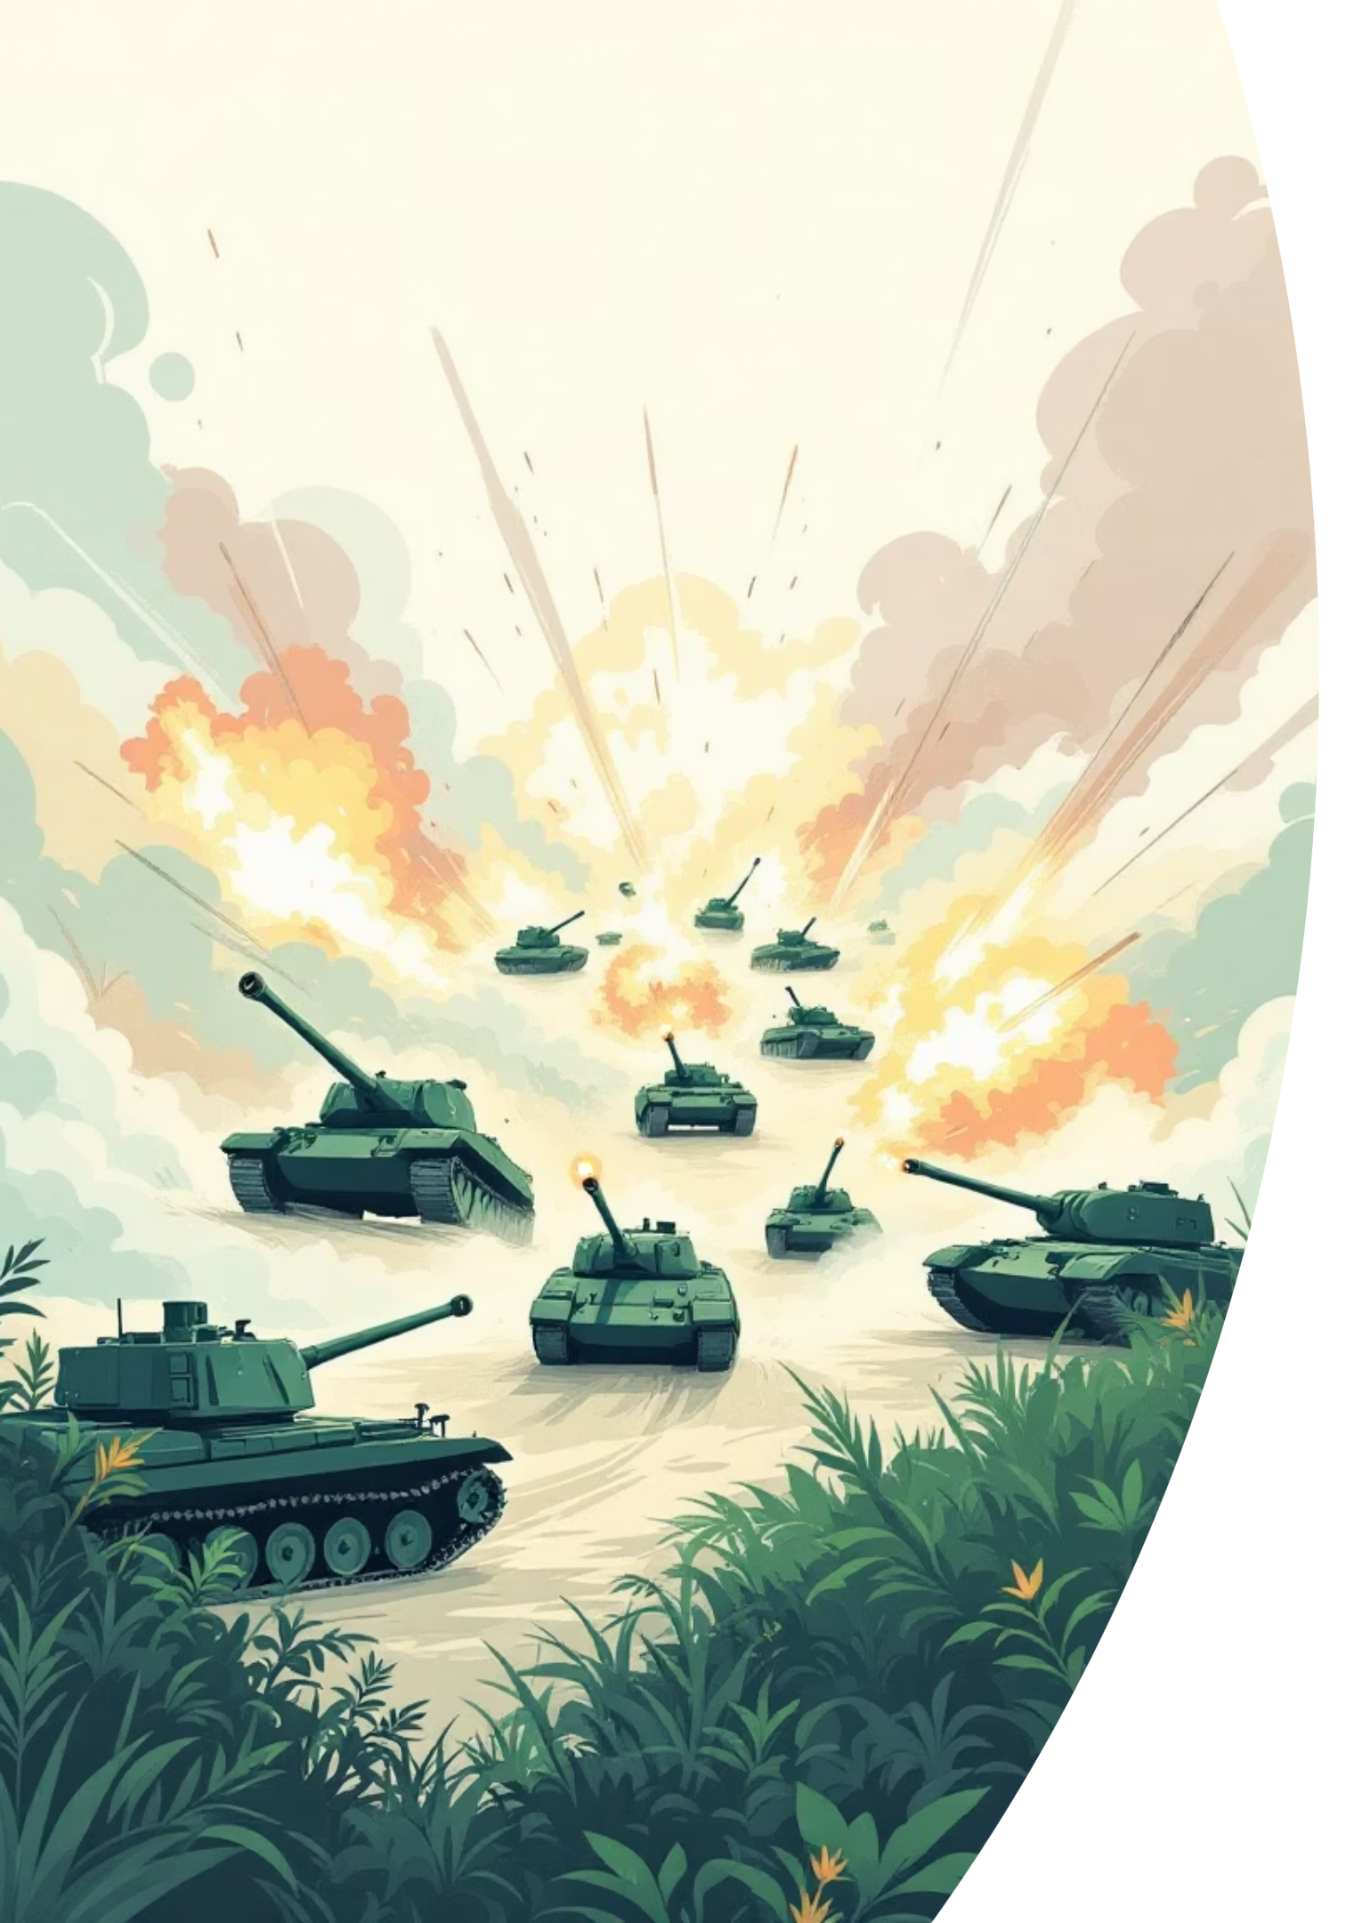
Game Features
Two-Player Mode
Team up or compete against a friend in local multiplayer battles
Intelligent AI
Face off against adaptive AI opponents that learn your tactics
Precision Combat
Master the physics-based shooting mechanics for perfect shots
Level Progression
Advance through increasingly challenging stages with unique objectives

Slide 4
Mission Objective
1
2
3
Eliminate Opponents
Level Requirements
Strategic Gameplay
Tank Arena challenges players to destroy a fixed number of enemy tanks to advance. Each level raises the stakes with tougher AI and more targets.
Victory conditions scale with difficulty—early levels may require 5 kills, while advanced stages demand 15+ eliminations under time pressure.
Success requires mastering movement patterns, ammunition management, and terrain advantages to survive waves of aggressive opponents.

Slide 5
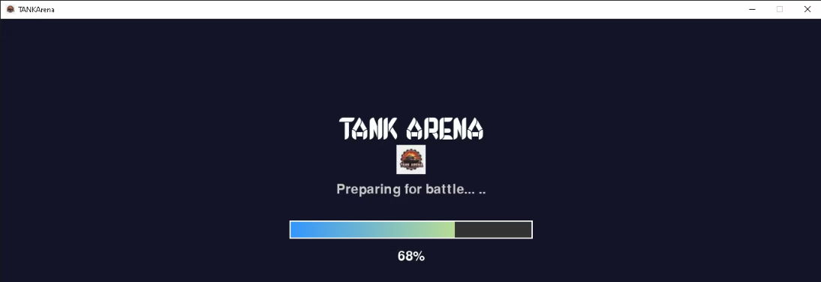
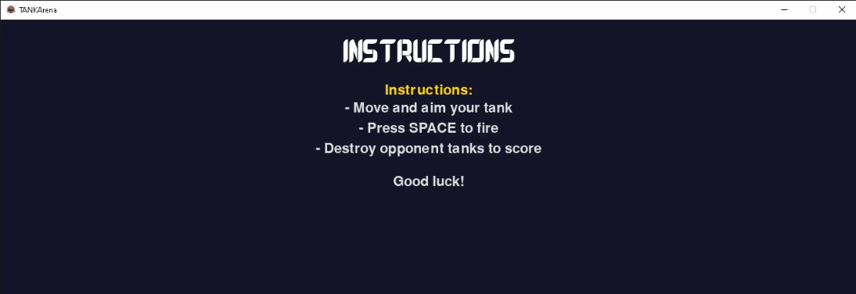
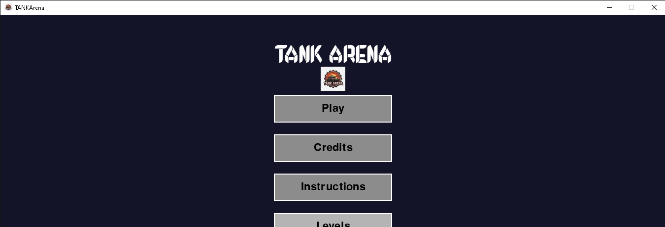
GAME FLOW
Overview
Loading Screen
Instruction Menu
Game Start
Immersive startup sequence prepares players for battle
Clear controls and gameplay tutorials guide new players
Jump into action with customizable settings and difficulty options
The game features a polished user interface that guides players from startup through victory, with intuitive menus and responsive controls throughout.

Slide 6
Game Files Organization Structure
Assets
Graphics, sprites, and visual elements
Audio
Sound effects, music tracks, and voice files
Scripts
Core game logic, AI behavior, and collision detection
Scenes
Level layouts, menus, and game states
Configuration
Game settings, parameters, and build files
A well-organized file structure ensures smooth development, easy debugging, and efficient asset management throughout the project lifecycle.

Slide 7
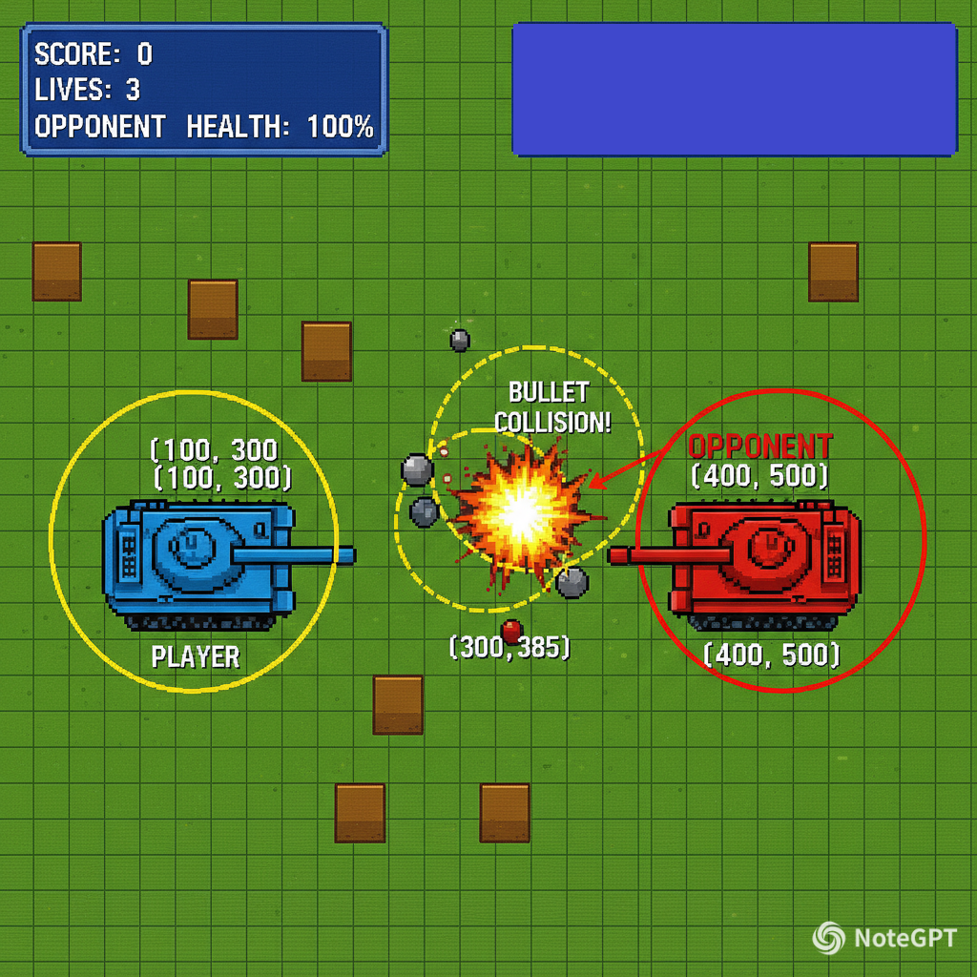


TECHNICAL DEEP DIVE
d =$√{(X2−X1)}^{2 }$ ${\text{(}\text{Y}\text{2 – }\text{Y}\text{1) }}^{2}$
Math Behind the Game
Collision Detection Logic
Tank Arena uses sophisticated mathematical algorithms to calculate precise bullet trajectories and collision detection between tanks, projectiles, and environmental obstacles.
01
Vector Calculations
Projectile direction and velocity based on angle and power
02
Bounding Box Detection
Real-time collision checking using rectangular hitboxes
03
Distance Formulas
Pythagorean theorem for proximity-based interactions
Physics simulations run at 60 FPS for smooth, responsive gameplay

Slide 8

Programming Language
Development Platform
Built using industry-standard game development tools and frameworks, enabling cross-platform compatibility and optimized performance for 2D graphics rendering.
Code Architecture
Object-oriented design principles ensure maintainable, scalable code with reusable components for tanks, projectiles, and game mechanics.
Technology stack chosen for rapid prototyping and professional-grade game development

Slide 9
ACKNOWLEDGMENTS
Credits
Development Team
Voice Credits
PPT Designer: Shravan Acharya
luvvoice.com
Programmer: Shravan Acharya
voicemode.com
Designer & Team Partner: Rahul Chetry
Music & Audio
Font
Epic Chase Music: From chosic.com by MaxKoMusic
Chrusty by Cove 703
Additional Music/Audio: mixit.com, uppbeat.com
Win/Lose Sounds: myinstants.com
Icons & Images
Backgrounds
Bullet Image: Missile icons by Those Icons – Flaticon
Explosion Image: Explosion icons by Freepik – Flaticon
Desert bg by Top Graphics and SVG Bundles (Pinterest)
Player Win Image: Instagram @spartafc_reddingca
Icy place bg by WallpapersHome (Pinterest)
Player Lose Image: Adobe Stock
Level 1 bg: Adobe Stock
Other Images: Created using AI

Slide 10



Thank You
Ready to dominate the arena? Let the battle begin!

